Slide 1
AN OVERVIEW OF ENFORCEMENT OFFICER MODULE(TRANSIT CASES)
DR.R.YEDUKONDALU,MVSc
Deputy Commissioner(ST)
Enforcement

Slide 2
CONTENTS
OFFICER MODULE FUNCTIONALITIES
HANDLING TRANSIT CASES

Slide 3
OFFICER MODULE FUNCTIONALITIES

Slide 4
Design Elements….
Case Management:
2 broad categories of cases- Goods in Transit & Other than transit
Same case management for both types of cases
Any case at any stage can be transferred to other enforcement officer/ module.
Prioritization of cases :
Case listings based on precise status of the current stage of a case (More than 45 such status).
Notifications in ‘My Tasks’.
MIS Reports on Enforcement.
‘Record Search’ functionality:
Officer may access GSTIN wise records including enforcement cases against a GSTIN within the state.
State Admin can assign ‘View All India Records’ role for select officers to access records of taxpayers across India.
A log of such data access is maintained in system and alert is sent to the jurisdictional Commissioner of tax officer(who initiated the request) and taxpayer (for whom the request was initiated).

Slide 5
Cases involving Goods in Transit (Section 129)
In cases of Goods in Transit
Interception of Conveyance
Physical Verification
Report (MOV- 04)
Recovery
No discrepancy
found
Release Order (MOV- 05)
Non- payment
of liabilities
Case initiation (MOV- 01)
Discrepancy found
On full payment of liabilities
Detention Order u/s 129(1) (MOV- 06)
+
Notice for Tax & Penalty u/s
129(3)
(MOV- 07)
Order for Physical Verification (MOV- 02)
Beyond
3 days
Provisional Release Bond (MOV- 08)
Extension of time for physical verification (MOV- 03)
Comes forward and
makes payment
Within
3 days
Demand Order u/s 129 (3)
MOV- 09
Payment made within 14 days of issuance of MOV- 06
If 14 day limit breached
Physical Verification
Report (MOV- 04)
Order for confisc ation u/s 130 (MOV- 11)
Notice for confiscation u/s 130
(MOV- 10)

Slide 6
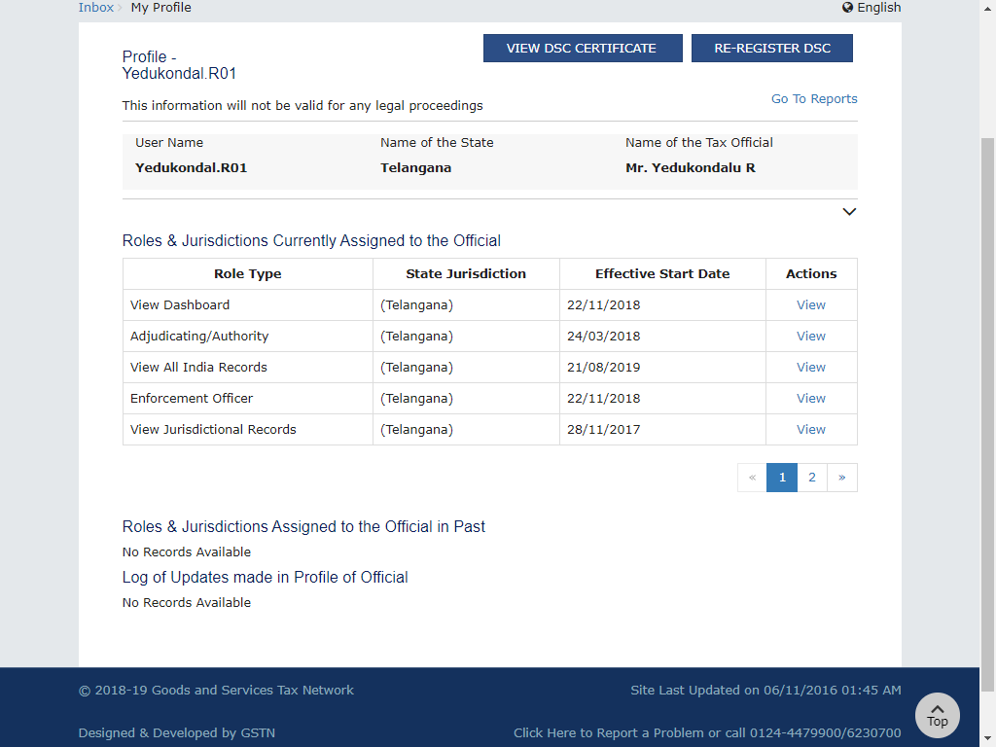
Roles & Jurisdiction of the Officer

Slide 7
Role of Officers

Slide 9
HANDLING TRANSIT CASES

Slide 10
INSPECTION OF GOODS IN MOVEMENT – CERTAIN ISSUES
Mismatch between Data Entry made in EWB-03A & EWB-03B and liability created through DRC-07
Jurisdiction issues among circles of Division and among Divisions of the State
Similarly issues with cases of Centre Jurisdiction
Time consuming process for creation of liability Through DRC-07(Details to be sent to Jurisdictional officer)
Possibility of off-setting cash for other liabilities

Slide 11
PURPOSE OF ENFORCEMENT MODULE
To keep the track of all the cases of fraud/tax evasion
Instant creation of Liability through DRC-07 along with approval of MOV-09
Proper officer can create liability without jurisdictional issues within the State
Once details entered, details will be auto-populated in other MOV-09 forms.
Once liability is created, it cab be set-off with credit/cash by the proper officer

Slide 12
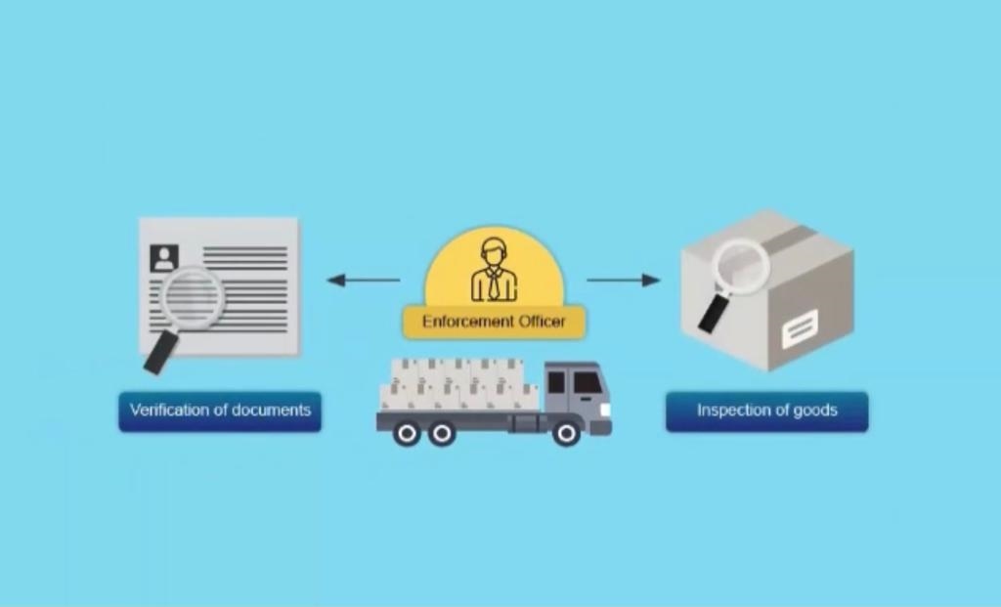
Role of proper officer for Inspection of Goods in Transit

Slide 14
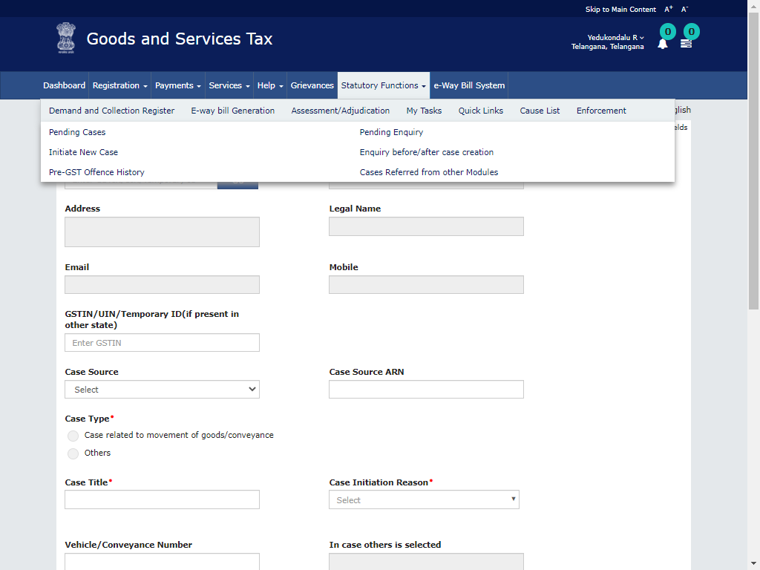
Initiate New Case

Slide 15
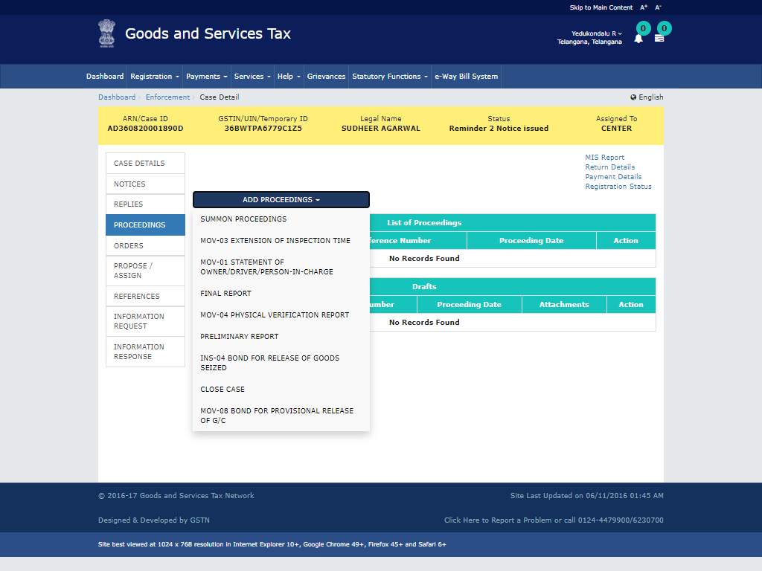
Proceedings in Transit Cases

Slide 16
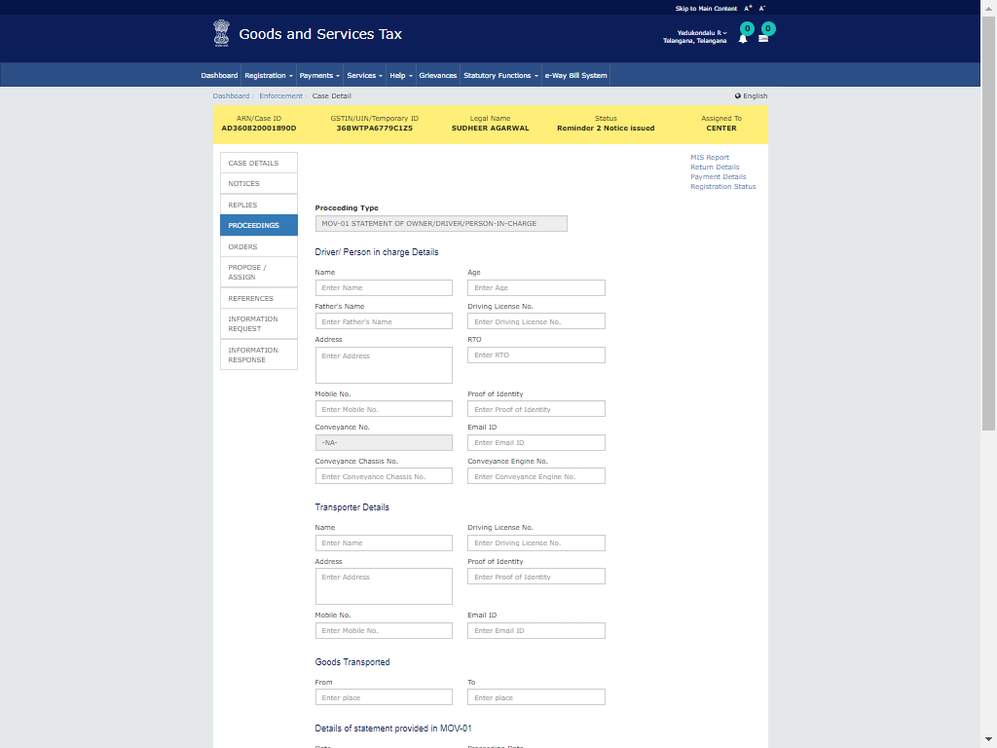
MOV-01 Statement of Owner/Driver

Slide 17
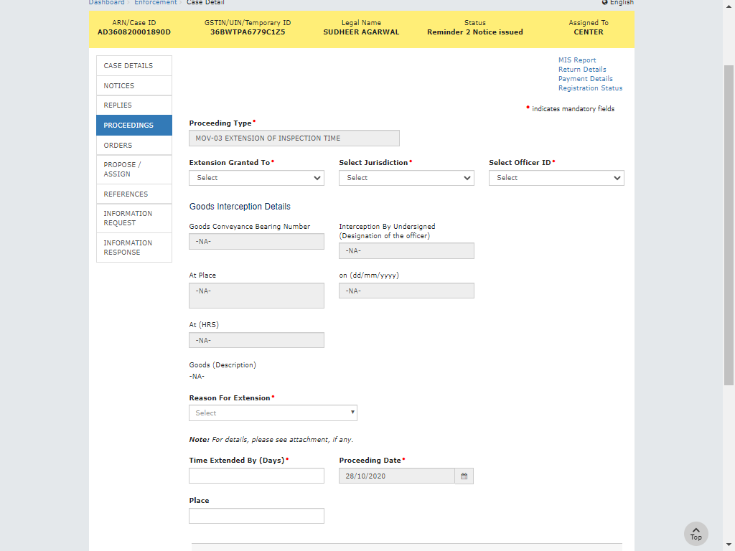
MOV-03 Extension of Inspection time

Slide 18
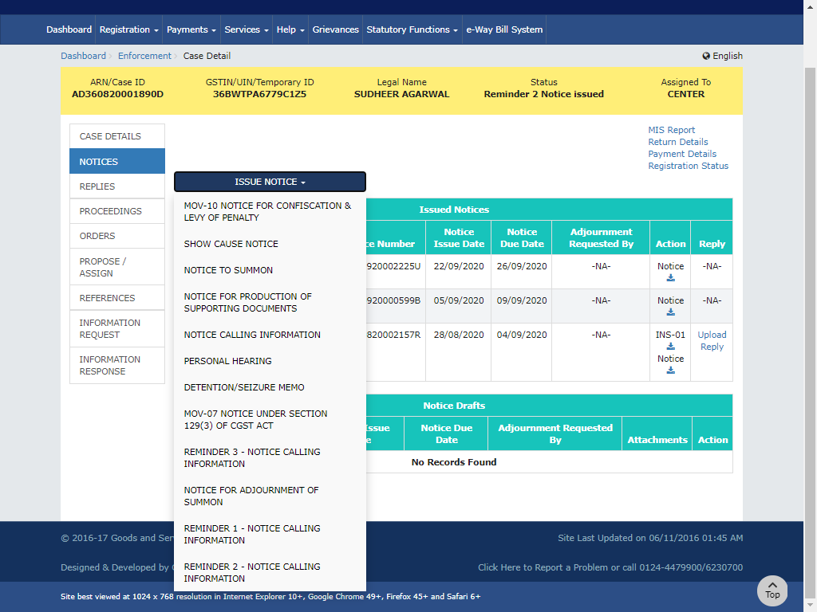
NOTICES (MOV-07 & MOV-10)

Slide 19
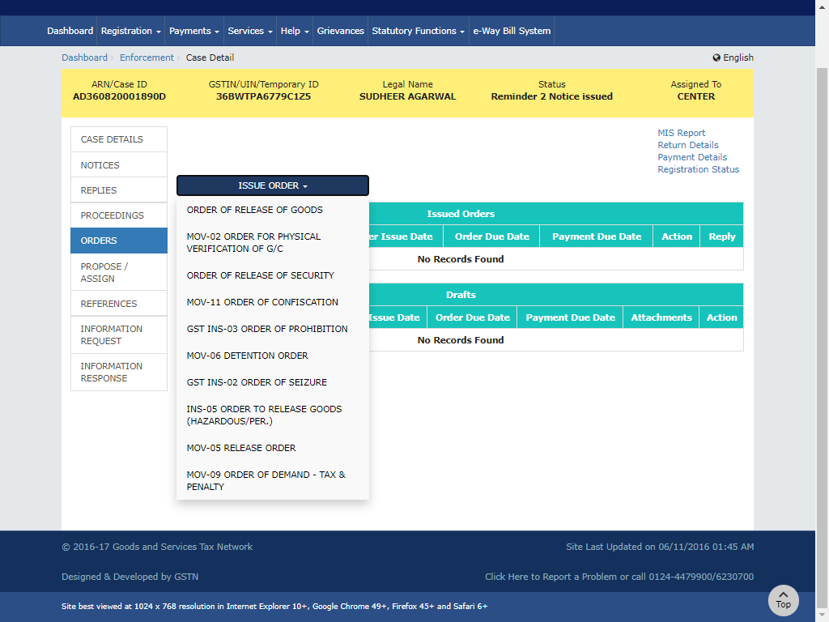
ORDERS(MOV-02; MOV-06; MOV-09 & MOV-11)

Slide 20
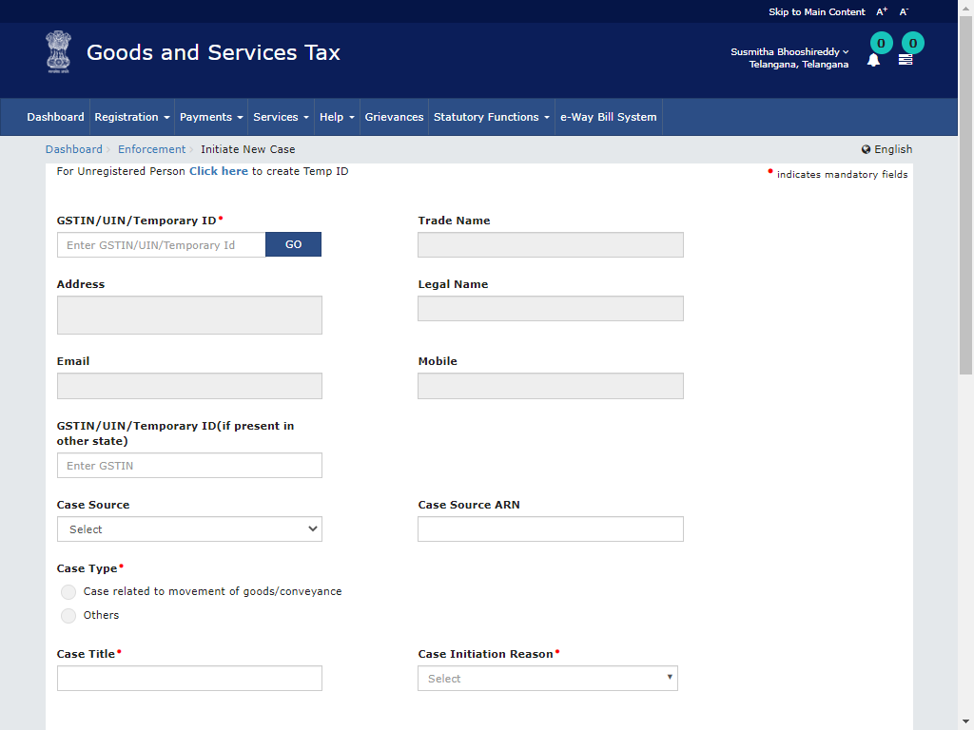
Initiate New Case

Slide 21
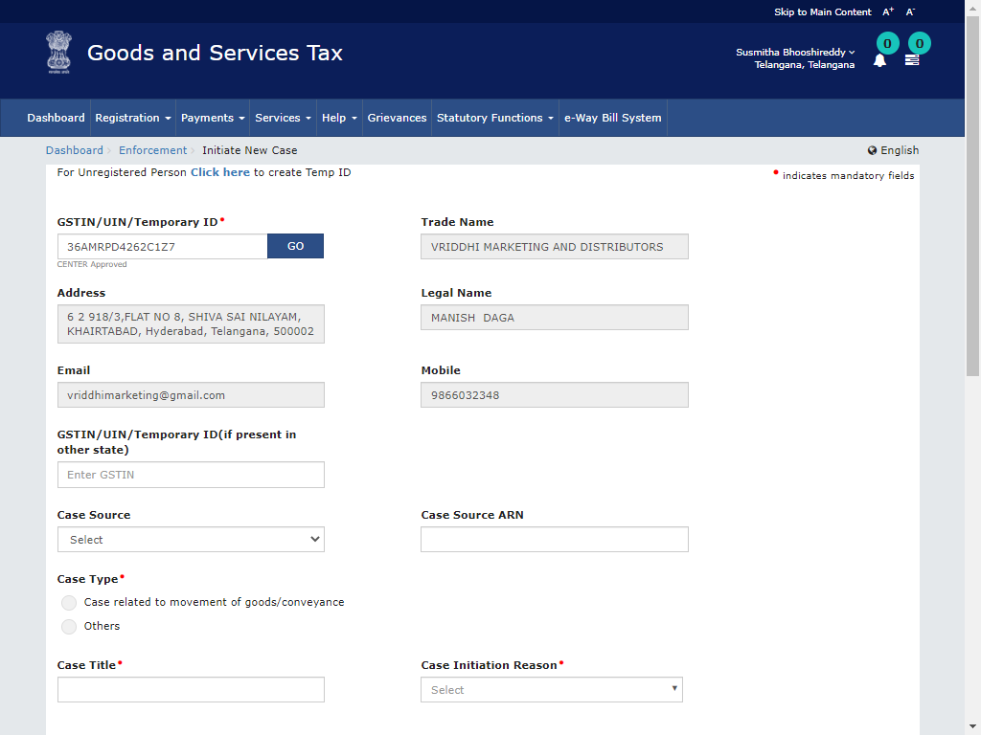
Initiate New Case

Slide 22
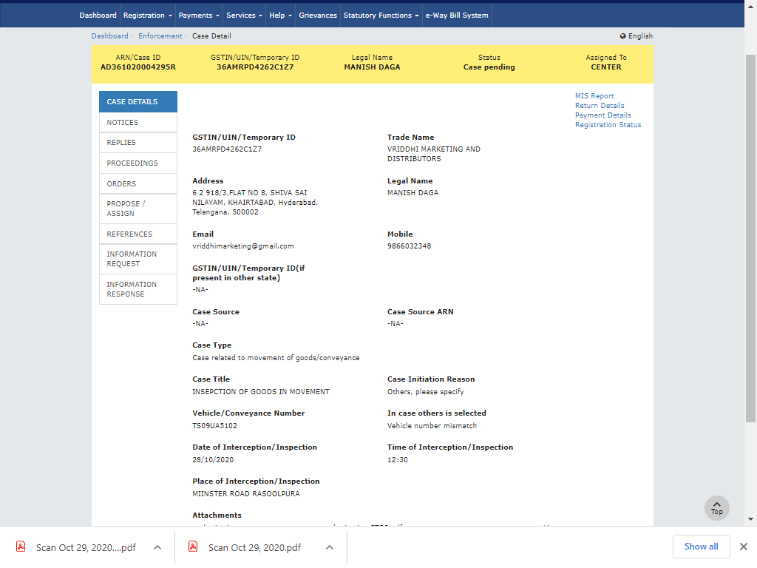
Case Details after creation of a case

Slide 23
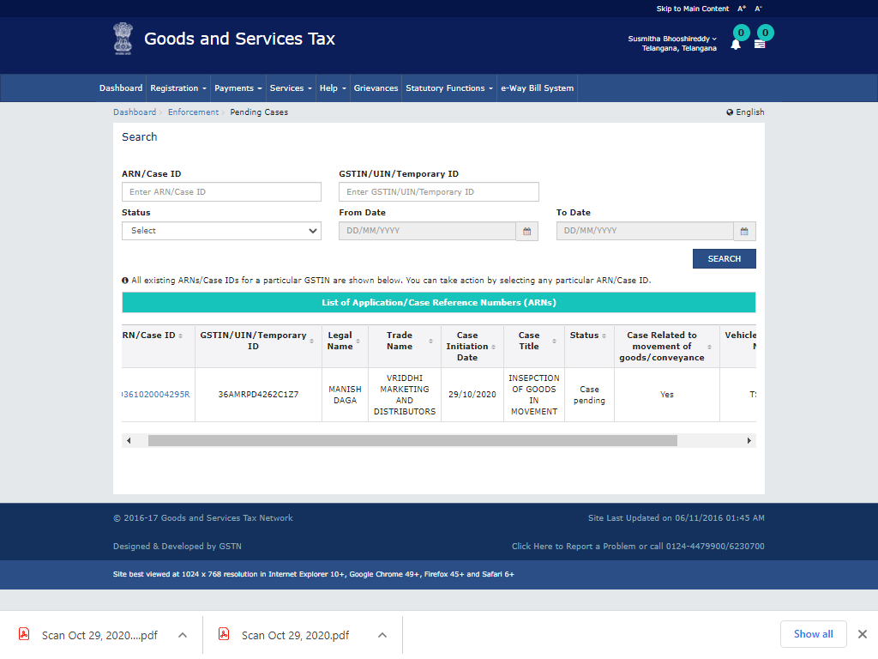
Case pending after creation

Slide 24
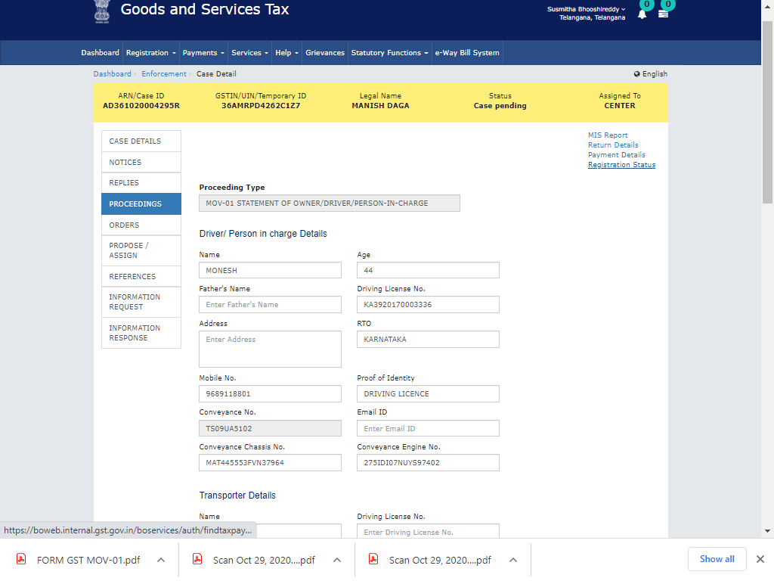
MOV-01

Slide 25
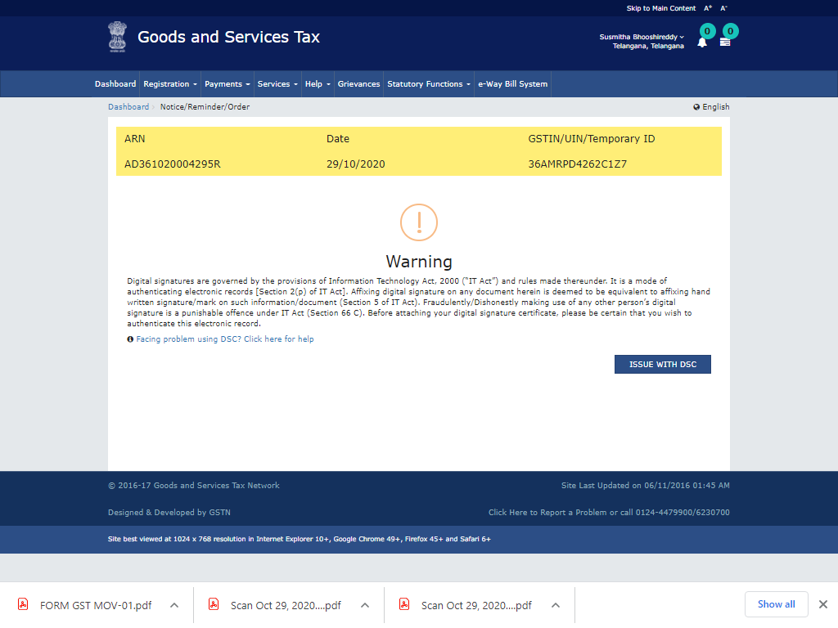
Issue with DCS

Slide 26
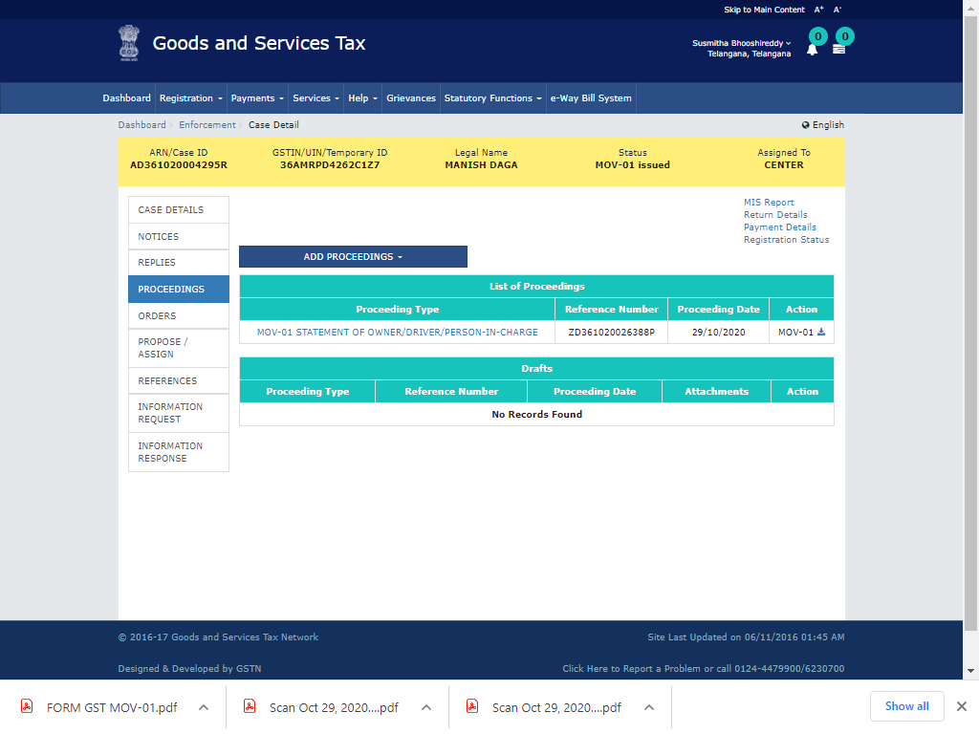
Issuance of MOV-01

Slide 27
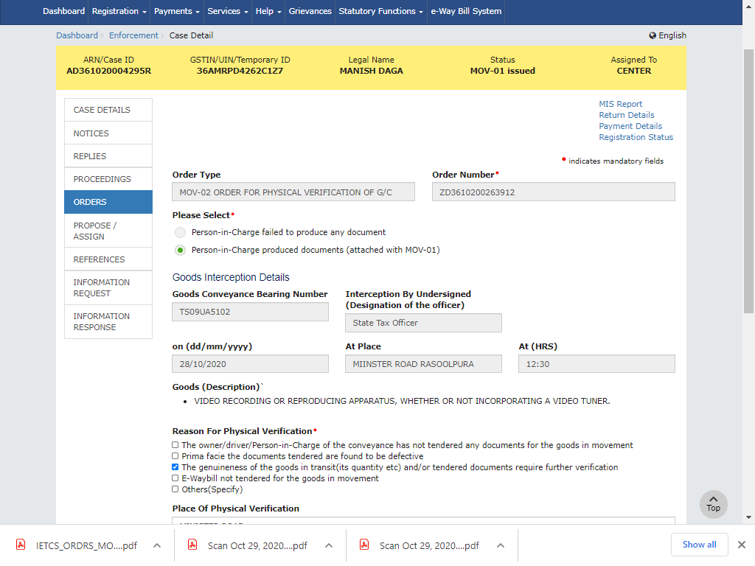
Issuance of MOV-02

Slide 28
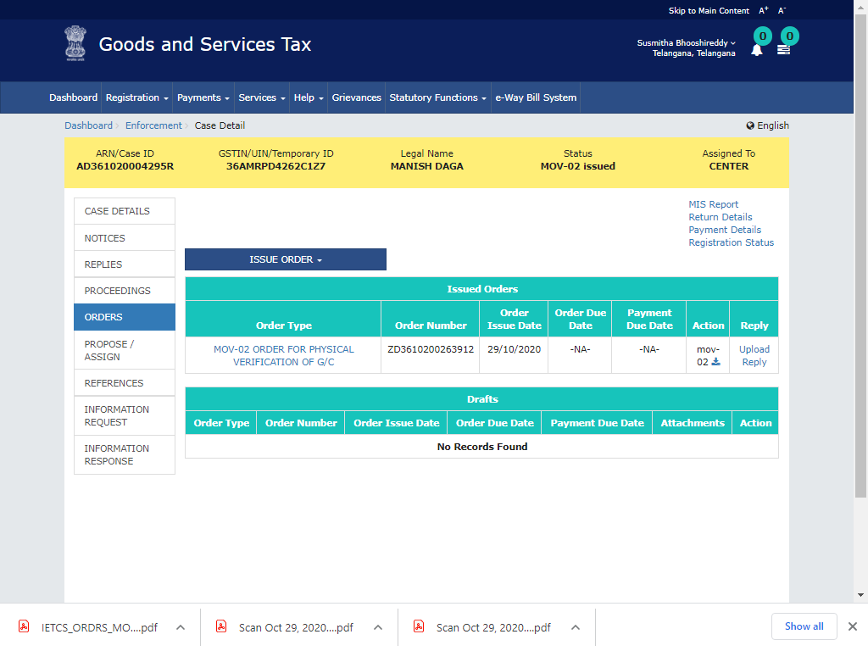
Issuance of MOV-02

Slide 29
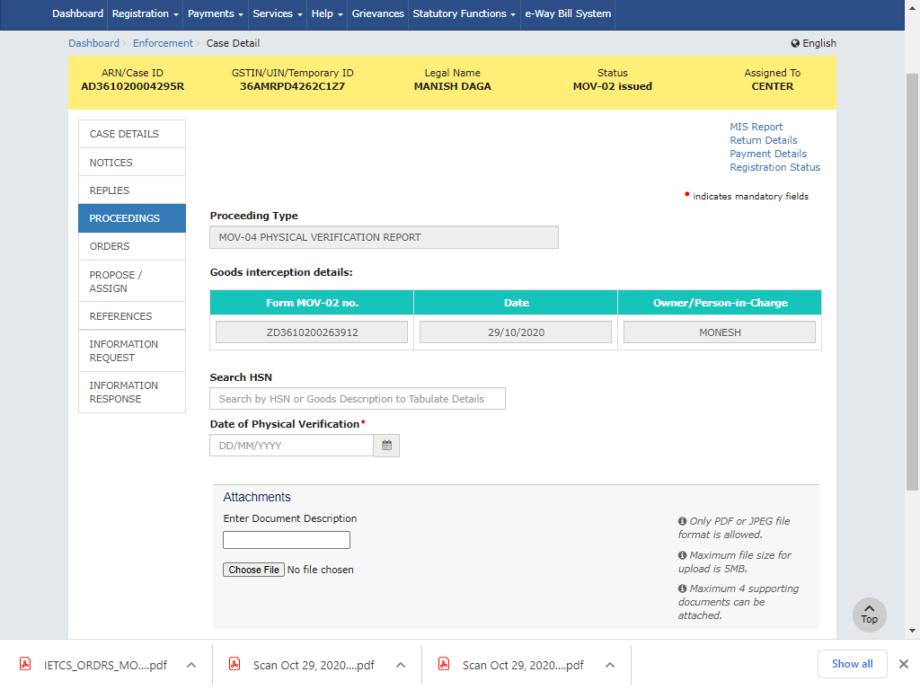
Issuance of MOV-04

Slide 30
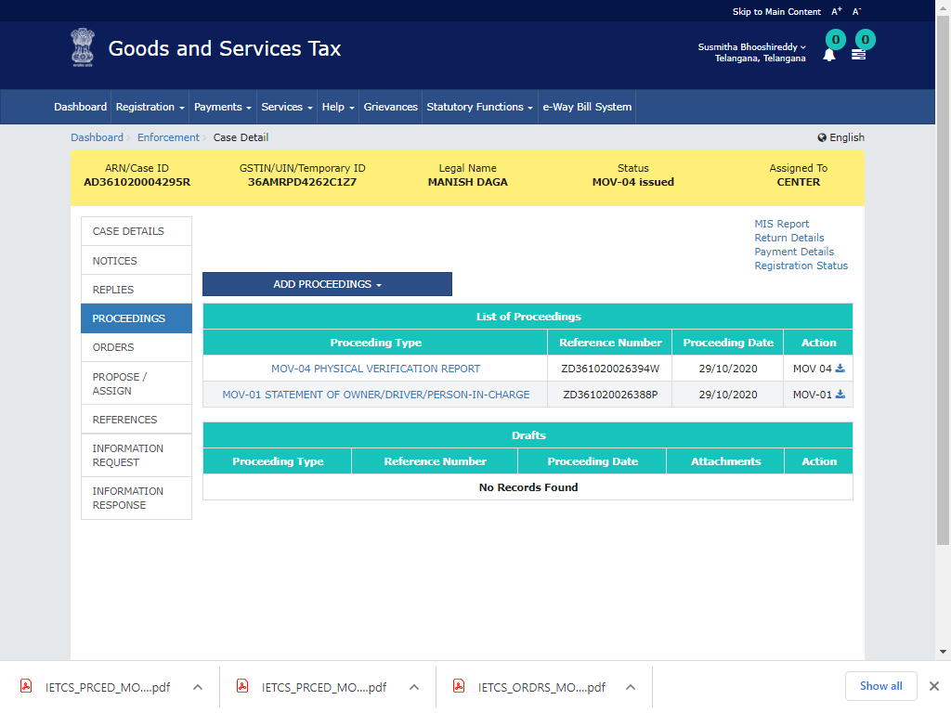
Issuance of MOV-04

Slide 31
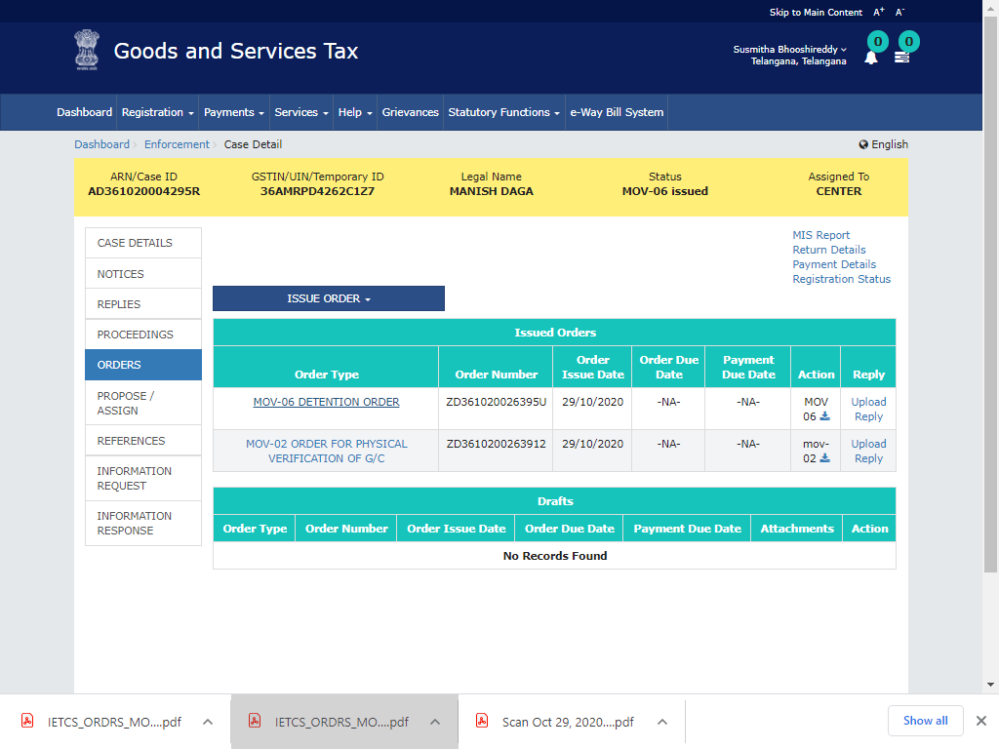
Issuance of MOV-06

Slide 32
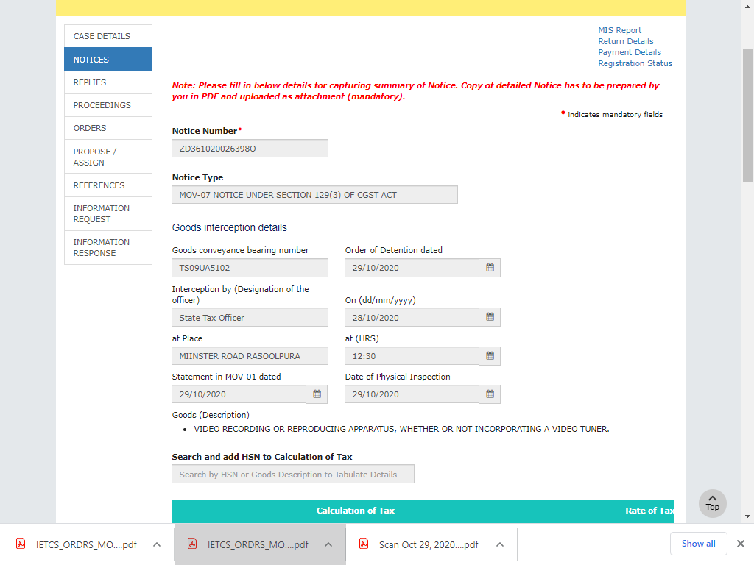
Issuance of MOV-07

Slide 33
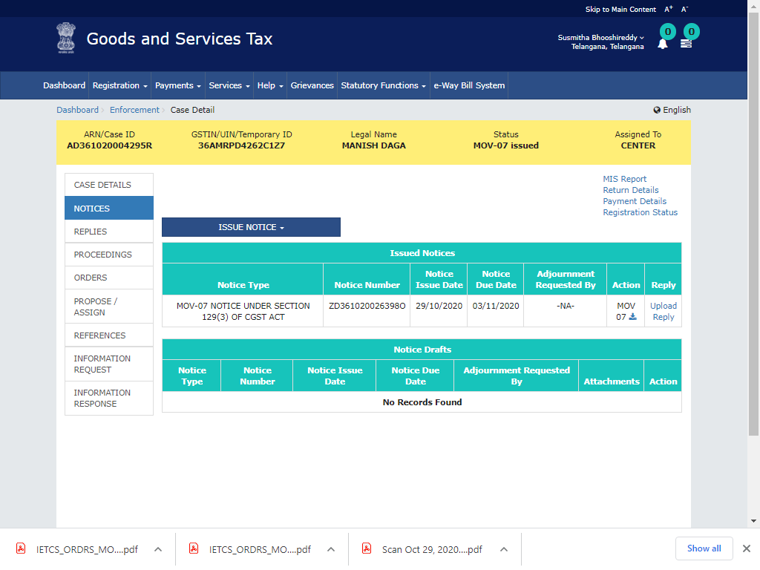
MOV-07 : Issued

Slide 34
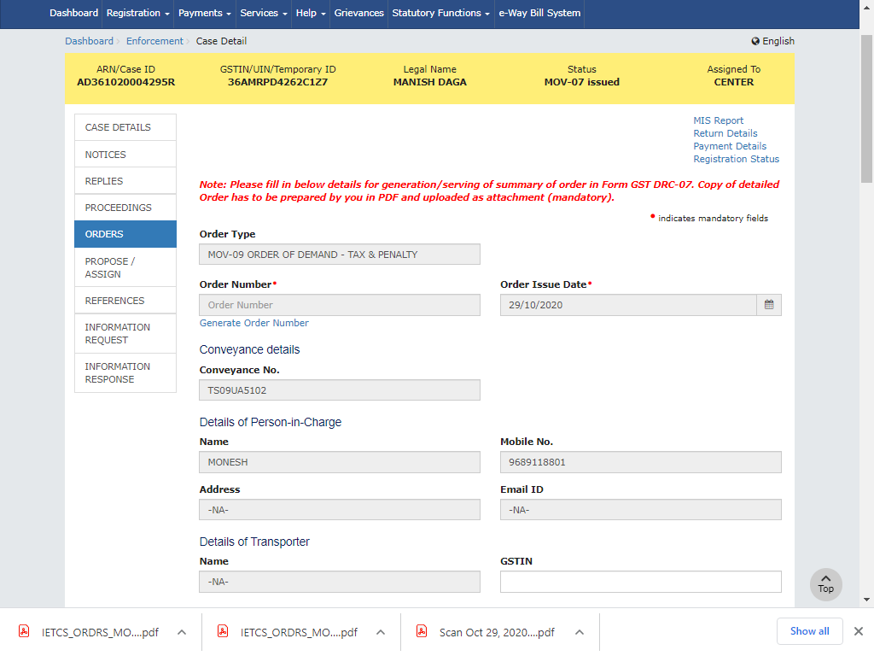
Issuance of MOV-09

Slide 35
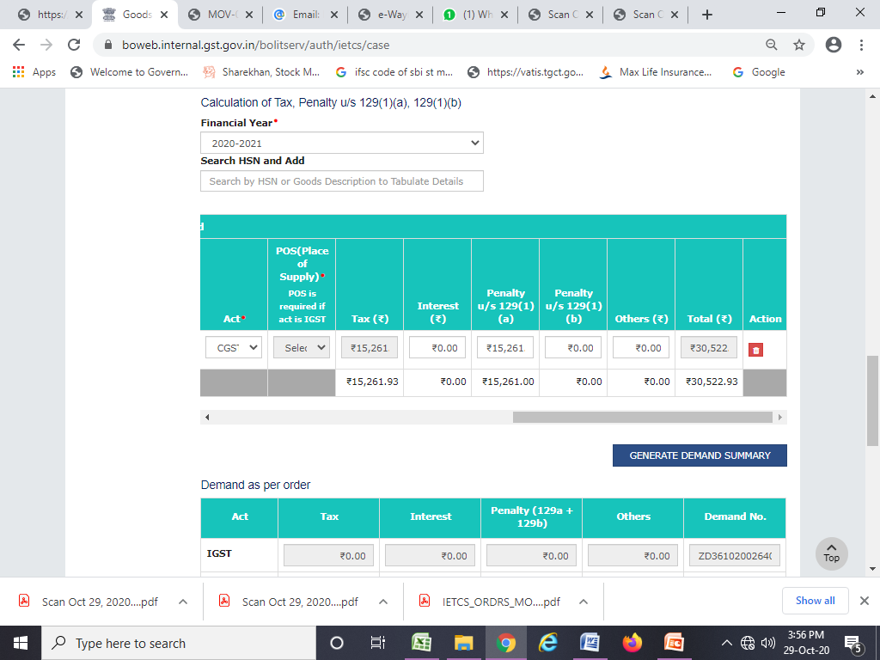
Calculation of Tax & Penalty(MOV-09)

Slide 36
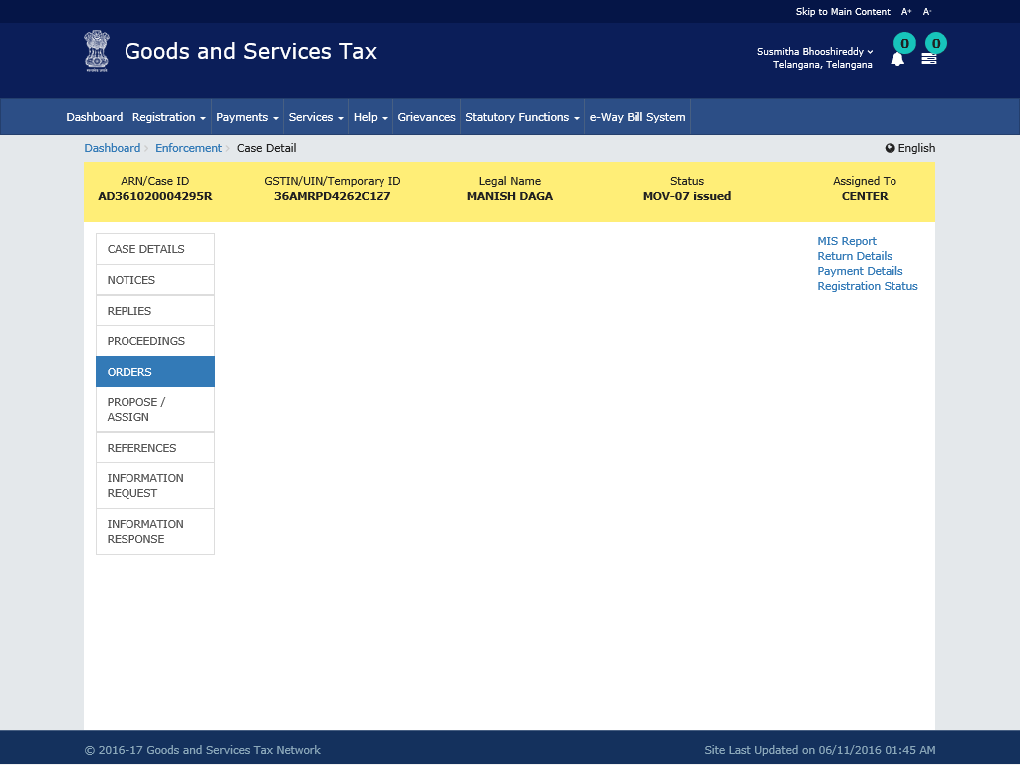
Status of the Case

Slide 37
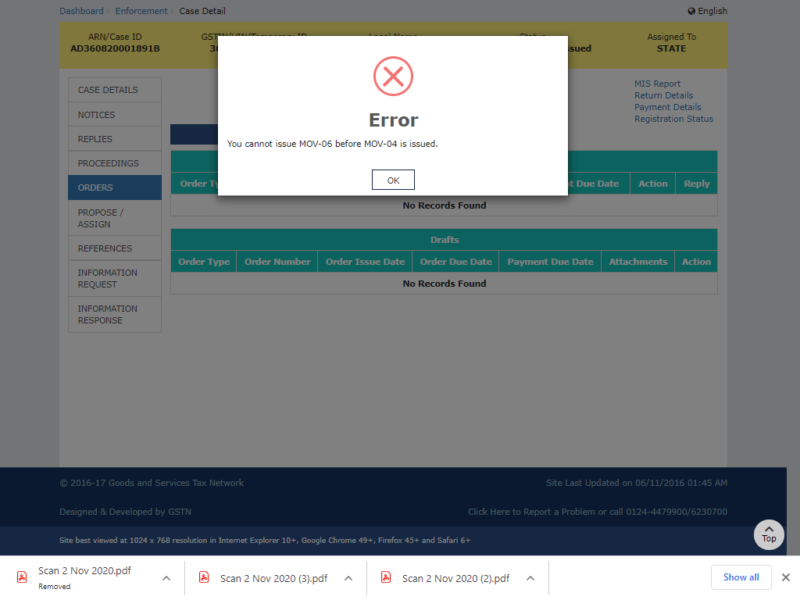

Slide 38
QUESTIONS
&
ANSWERS

Slide 39
THANK YOU

